Slide 1
Database Development & Design
Attributes, Keys, and Constraints

Slide 2
Outline
Attributes
keys Types
Keys Categories
Database constraints

Slide 3
Attributes
Attribute: attributes are the describing characteristics or properties that define all items pertaining to a certain category applied to all cells of a column.
Simple attribute: are atomic values, which cannot be divided further; For example, SSN or Sex.
Composite attribute: are made of more than one simple attribute; For the example the Address attribute of the EMPLOYEE entity can be subdivided into (Street_address, City, State, and Zip). Another example the Full Name can be subdivided into (FirstName, MiddleName, and LastName).
Derived attribute: are the attributes that do not exist in the physical database, but their values are derived from other attributes present in the database. For example, the value of Age can be determined from the current (today’s) date and the value of that person’s Birth_date.
Multi-value attribute: Multi-value attributes may contain more than one values. For the example a College_degrees attribute for a person: one person may not have a college degree, another person may have one, and a third person may have two or more degrees. Another example, color of a car; a car may have more than one color.
Complex attribute: multi-value attribute and composite attribute. For example, an employee with two addresses.

Slide 4
Keys
A key is a field in a table that is used in the identification of that record. They ensure each record within a table can be uniquely identified by one or a combination of fields within the table. They help enforce integrity and help identify the relationship between tables.
Keys Types:
Super Key
Candidate Key
Primary Key
Secondary Key or Alternative Key
Foreign Key

Slide 5
Keys Types
Super Key (SK): any combination of fields within a table that uniquely identifies each record within that table (No two tuples will have the same value for SK). Any set of attributes that includes a key is a super key.
Candidate Key: a key that contains the least possible attributes, and that maintains the criteria that it can uniquely identify any table row (subset of a super key).
Primary Key: One candidate key from the set of all possible candidate keys is chosen to be the primary key.
Secondary Key or Alternative Key: keys left after chose the PK from candidate keys.
Foreign Key: a primary key from one table that appears as a field in another table, where the first table has a relationship to the second table.

Slide 6
Keys – Example
StudID | Stud_fname | Stud_lname | Stud_phone | Stud_email | Stud_address | Department_No
1 | John | Smith | 1234567890 | john@example.com | 123 Main Street | 101
2 | Alice | Johnson | 9876543210 | alice@example.com | 456 Park Avenue | 102
3 | Bob | Williams | 5551234567 | bob@example.com | 789 Broadway Boulevard | 101
4 | Jane | Brown | 7778889999 | jane@example.com | 101 Oakwood Drive | 103
Foreign Key: Department_No
Super keys:
{StudID}, {Stud_fname, Stud_lname}, {Stud_phone}, {Stud_email}, {Stud_address}, {Stud_fname, Stud_lname, Stud_phone}, {StudID, Stud_email}, {Stud_fname, Stud_lname, Stud_address, Department_No}, Etc.
Candidate keys: {StudID}, {Stud_phone}, {Stud_email}, {stud_address}
Primary key: {StudID}
Alternative Keys: {Stud_phone} , {Stud_email}, {stud_address}

Slide 7
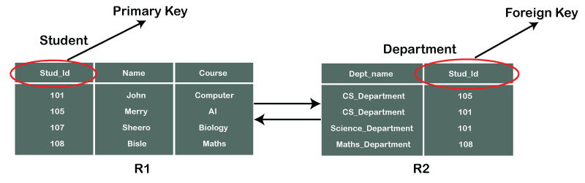
Keys – Example

Slide 8
PK Vs. FK
 | Primary key | Foreign key
Basic | It is used to uniquely identify data in the table. | It is used to maintain relationship between tables.
NULL | PK Can not accept null values | FK can accept multiple null values
Duplicate | Only one primary key in a table | More than one foreign key in a table

Slide 9
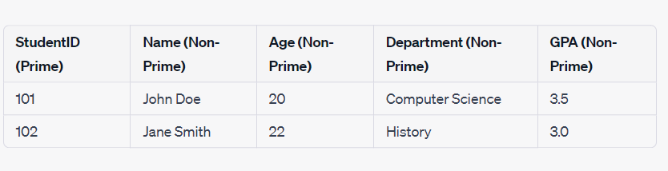
Prime and Non-Prime Attributes
Prime attributes: are attributes that are part of the candidate key(s) in a relation.
Non-prime attributes: are attributes that are not part of the candidate key(s) in a relation.
“StudentID" is candidate key, making it prime attributes.
Other attributes are non-prime as they aren’t part of any candidate key!

Slide 10
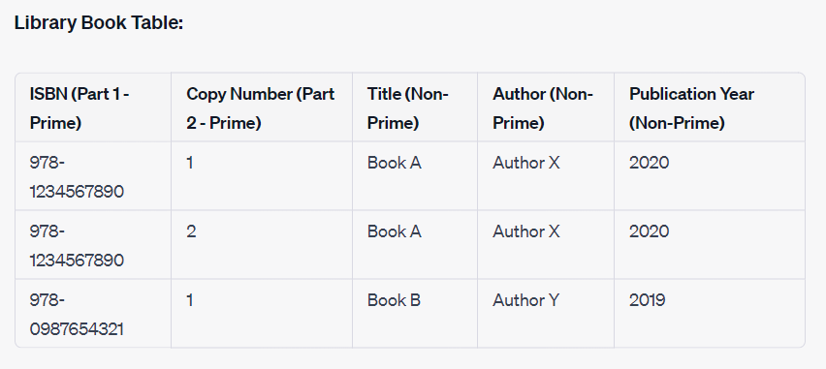
Prime and Non-Prime Attributes
Prime attributes: are attributes that are part of the candidate key(s) in a relation.
Non-prime attributes: are attributes that are not part of the candidate key(s) in a relation.
"ISBN" and "Copy Number" together form the composite candidate key, making them prime attributes.
Other attributes are non-prime as they aren’t part of any candidate key!

Slide 11
Keys Categories
Natural Key:
  a natural key is an attribute that exists in the real world or is used by the business. It can be used to uniquely identify the row.
  An example of a natural key is a Social Security Number (for US citizens). It’s usually a unique number that applies to a person and has a use for tax purposes. In Australia, they have a Tax File Number (TFN) which has a similar purpose. It’s a way to uniquely identify a record, and actually has a meaning in the world outside the database.
Surrogate Key:
  A surrogate key is an attribute that is invented or made up for the sole purpose of being used as the primary key. It has no value to the business or the real world.
  Surrogate keys are often used when there is no other way to identify a record – when there is no natural key. They are often an integer value, starting at 1 and incrementing for each new record.
  Example: customer ID , employee ID, etc.

Slide 12
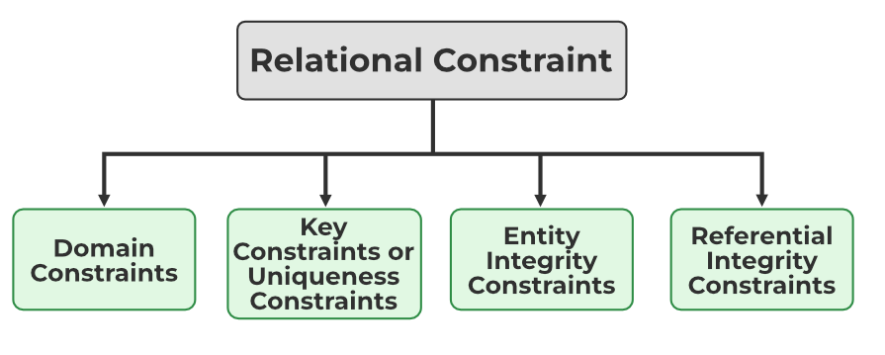
Constraints
Constraints: restrictions or sets of rules imposed on the database contents. It validates the quality of the database. It validates the various operations like data insertion, updating, and other processes which have to be performed without affecting the integrity of the data. So, it protects us against threats/damages to the database.

Slide 13
Constraints
NOT NULL: makes sure that a column does not hold NULL value
  Example: Student Name shouldn’t be null.
UNIQUE: enforces a column to have unique values (cannot have duplicate values).
  Example: Product code should be unique.
  Example: department name should be unique.
DEFAULT: provides a default value to a column when there is no value provided while inserting a record into a table.
  Example: Default country for student birth in HTU is Jordan.
CHECK: used for specifying range of values for a particular column of a table.
  Example: "OrderStatus" column can only have values 'Pending,' 'Shipped,' or 'Delivered.’
  Example: GPA should be more than 80 to attend IT College.

Slide 14
Constraints
DATA TYPE: Each table has certain set of columns, and each column allows a same type of data, based on its data type. The column does not accept values of any other data type.
  Example: Age column should have integers only (discard months)
Domain constraints: data type + Constraints (NOT NULL / UNIQUE / CHECK / DEFAULT).
  Example: "Email" column is of type VARCHAR and has both UNIQUE and NOT NULL constraints
Referential Integrity Constraints (Mapping constraints): foreign key constraints and mapping cardinality (relation).
  Example: The "AssigneeDoctorID" in the "Appointments" table is a foreign key that references the "Doctors" table, ensuring that only valid doctor IDs can be assigned to appointments.

Slide 15
References
Elmasri, R., & Navathe, S. (2017). Fundamentals of database systems (Vol. 7). Pearson
Eng. Lina’s slides
Dr. Raneem’s slides.

